Slide 1
Federal Reserve Economic Data (FRED): Exploratory Data Analysis
BUSN 32120
James Goyette, Jhumi Parimal, Elizabeth Sun

Slide 2
Target Audience & Research Question
Series ID | Description | Why Included
PSAVERT | Personal Savings Rate (%) | Primary variable of interest
UNRATE | Unemployment Rate (%) | Key labor-market indicator
CPIAUCSL | Consumer Price Index (All Urban, SA) | Inflation pressure on saving capacity
UMCSENT | U. Michigan Consumer Sentiment Index | Forward-looking consumer confidence
DSPIC96 | Real Disposable Personal Income | Income actually available to save
FEDFUNDS | Effective Federal Funds Rate (%) | Interest-rate environment for savers
PCEPI | PCE Price Index | Alternative inflation gauge (Fed-preferred)
RSAFS | Advance Retail Sales (millions, SA) | Consumer spending, an inverse proxy for saving
REVOLSL | Revolving Consumer Credit Outstanding (billions, SA) ★ | Direct counter-signal to savings
CSUSHPISA | S&P/Case-Shiller U.S. National Home Price Index ★ | Household wealth and housing-cost context
AHETPI | Avg Hourly Earnings -- Production & Nonsupervisory ★ | Wage trajectory and real purchasing power
HOUST | Privately-Owned Housing Starts (SAAR, thousands) ★ | Big-ticket commitment that competes with saving
Audience: Everyday American consumers + personal finance advisors; no economics background assumed
Question: How has the U.S. savings rate shifted post-COVID, and which macro factors (unemployment, inflation, sentiment, income) drive Americans to save more or less?
Motivation: Savings spiked to ~32% in April 2020 (caused by stimulus and prolonged lockdowns), then collapsed below pre-pandemic norms by 2022; understanding why helps consumers act and advisors advise proactively
Data: 12 monthly FRED series, Jan 2015 to Dec 2024 (120 observations); seasonally adjusted, zero missing values
Three Eras: Pre-COVID (2015–19) baseline → COVID (2020–21) shock → Post-COVID (2022–24) normalization

Slide 3
Initial Data Inspection & Data Cleaning Findings
The data loaded cleanly: Our full dataset contains 120 monthly observations across all 12 FRED series, with zero missing values across every column
This was a strong signal that FRED's standardized, seasonally-adjusted data is a reliable foundation for this analysis
One immediate outlier stood out: Summary statistics revealed a savings rate maximum of 31.8%, which was dramatically above the series mean of 7.2%
Rather than flagging this as a data error, we recognized it as a real, consequential economic event: the April 2020 CARES Act stimulus spike, which we retained for exactly that reason
Cleaning was deliberate and conservative: We applied a defensive data cleaning step to guard against any future gaps in FRED's source data, confirming that no rows were lost in the process; the dataset remained fully intact at 120 observations
Era labels unlocked time-series analysis: A key preparation step was assigning each month to one of three economic eras: Pre-COVID (2015–2019), COVID (2020–2021), and Post-COVID (2022–2024). A classification that becomes central to nearly every finding in the slides that follow

Slide 4
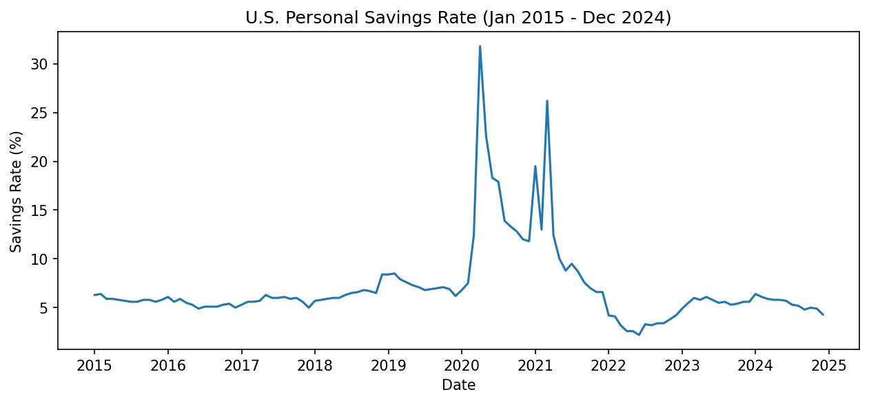
Initial Analysis of Savings Rates Findings
Top 5 savings months: All COVID-era (April 2020 leads at 31.8%); stimulus payments + suppressed spending
Bottom 5 savings months: All in 2022, clustered around 3%: the same households hit a historic floor just two years later
The chart tells the full story: Stable 6 - 8% baseline → near-vertical spike to 32% → secondary 2021 bump (3rd stimulus) → steep descent below pre-pandemic baseline by mid-2022, staying there through 2024
Key implication: The savings environment has structurally worsened since the pandemic, not recovered
Implication for financial advisors and clients: The post-COVID floor of 3 - 5% is the “new” modern benchmark; any savings plan built on the assumption that a household "should" be saving 6 - 8% needs to account for the macro headwinds that have made that target materially harder to hit since 2022

Slide 5
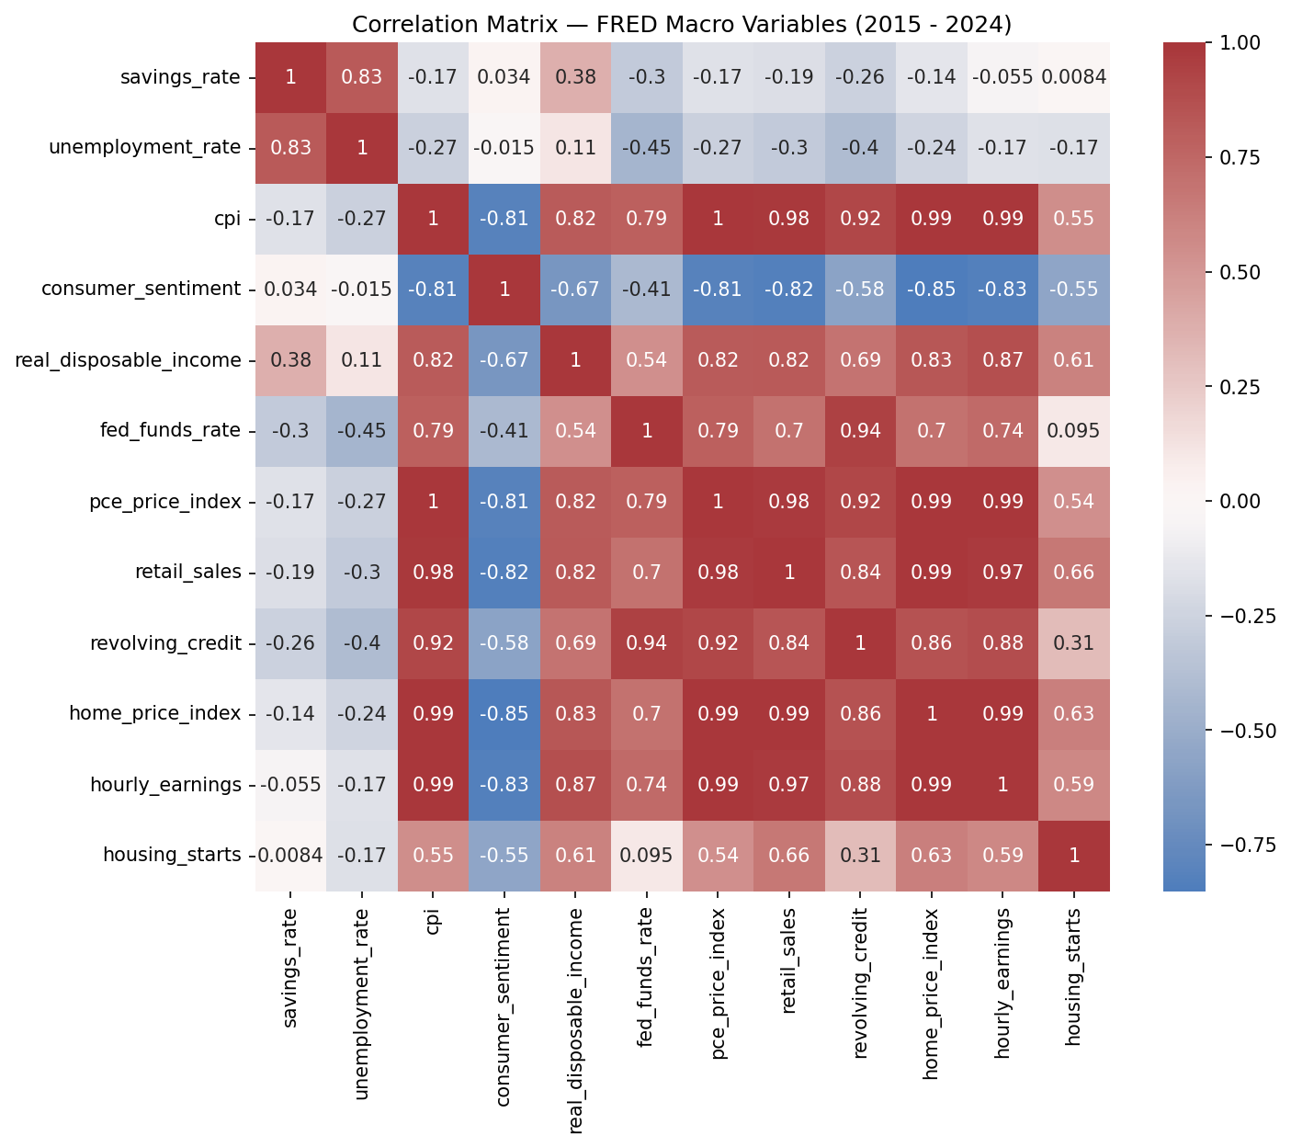
Correlations Between Savings Rate & Other Series
Unemployment (r = 0.83): Strongest positive correlation, but almost entirely a COVID artifact; stimulus and job losses spiked simultaneously; the relationship disappears outside that window
Real disposable income (r = 0.38): The more economically meaningful positive signal; holds across all three eras
Strongest negative correlations: Retail sales (spending), revolving credit (borrowing), and the federal funds rate; higher spending and borrowing directly crowd out saving
Heatmap insight: CPI, PCE, retail sales, home prices, and hourly earnings all move in lockstep (shared inflationary trend); consumer sentiment moves opposite that cluster, and it falls when prices and spending rise
Implication for financial advisors and clients: When advisors see inflation rising, retail spending climbing, and revolving credit balances growing simultaneously (as has been the case since 2022), the data suggests these three forces impede a client's ability to save, indicating opportunities to pursue proactive savings conversations

Slide 6
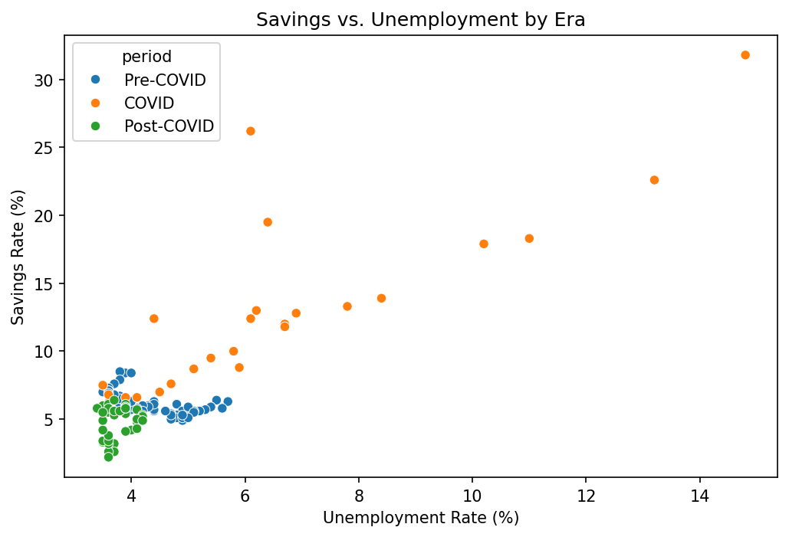
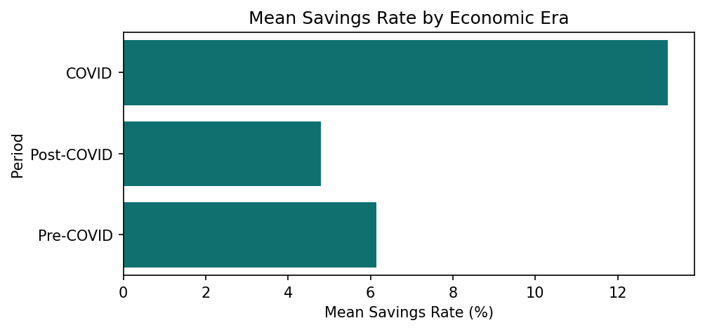
Era Comparisons & COVID vs. Non-COVID
Post-COVID is the worst savings era despite income being highest: mean savings rate just 4.8% vs. 6.1% pre-COVID; inflation, housing costs, and credit are absorbing income gains
Scatterplot (savings vs. unemployment by era): Confirms the COVID coupling is purely stimulus-driven, not a structural relationship
Mean savings bar chart - the single clearest takeaway: COVID highest (13.2%, stimulus-driven) → Pre-COVID middle (6.1%) → Post-COVID lowest (4.8%), illustrating a structural decline
COVID vs. non-COVID comparison: Savings averaged 13.2% during COVID vs. 5.6% outside it; revolving credit was actually lower during COVID ($990M vs. $1.08B)
Counter-intuitive sentiment finding: Consumer sentiment was lower during COVID (79.6 vs. 84.1) yet savings were dramatically higher; this suggests uncertainty triggers precautionary saving behavior
Implication for financial advisors and clients: A drop in consumer sentiment may actually be an early leading indicator that clients are about to increase their savings buffers, which is a useful signal for proactive planning

Slide 7
Second-Degree Analysis and Findings Using Normalized Data (1)
Two new features engineered: Savings-to-income ratio (savings as share of take-home) and credit-to-income ratio (revolving debt relative to income)
Top savings-to-income months: Identical to raw savings rankings; April 2020 leads, confirming the ratio behaves consistently
Credit-to-income direction: Higher values = more revolving debt relative to income, consistent with correlation findings (revolving credit is one of the strongest inverse signals to savings)
Scale mismatch discovered: Savings-to-income ranges from 0.00014–0.00177; credit-to-income ranges from 46–76; raw comparisons between them would be misleading, motivating MinMaxScaler normalization for regression
Implication for financial advisors and clients: When a client's revolving debt is rising faster than their income, even as their nominal paycheck grows, then the data suggests that income gain is being absorbed by borrowing rather than converted into saving; monitoring a client's credit-to-income trajectory alongside their savings rate may be more diagnostic than either number alone

Slide 8
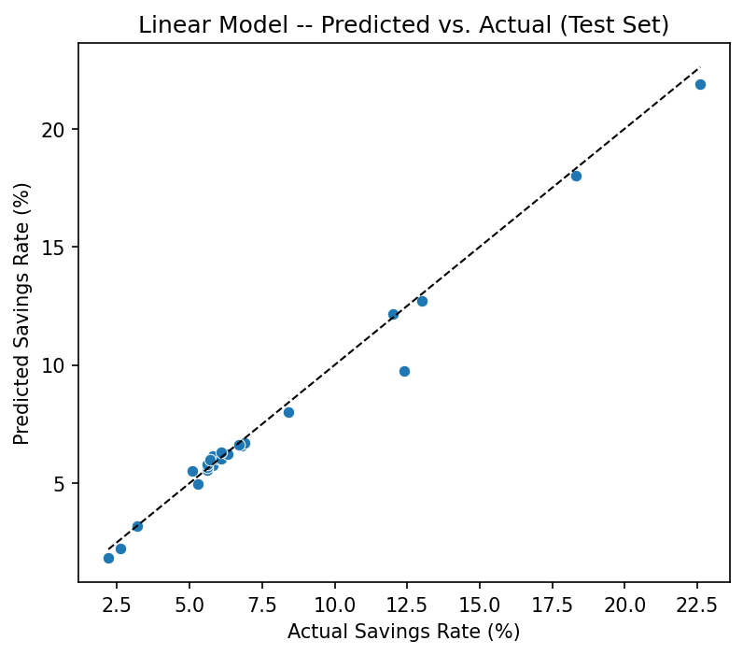
Second-Degree Analysis Using Normalized Data (2) – Linear + Logistic Regression
Why normalize first: 12 features span different units (percentages, billions, index values) — scaling to 0–1 prevents any single feature from dominating due to magnitude alone
Linear model - top drivers: Real disposable income has the largest positive coefficient (+31.23); retail sales has the largest negative (−19.56), capturing the spending-vs-saving tradeoff
Model fit: R² = 0.983, RMSE = 0.6 pp - fits well, but high R² partly reflects strong collinearity among macro features (CPI, PCE, retail sales, home prices, earnings all move together)
Wages → spending, not saving: Hourly earnings carries a negative coefficient (−8.15) despite being an income measure - wage growth has been absorbed by consumption, consistent with the post-COVID era finding
Logistic model: 83.3% accuracy classifying high- vs. low-savings months; 90.9%; 76.9% recall (caught ~77% of actual high-savings months)
Implication for financial advisors and clients: Advisors should not wait for a macro signal to initiate savings conversations; when consumer sentiment drops or inflation rises, proactive outreach is warranted even before the data fully confirms a shift in savings behavior

Slide 9
Recommendations for Audience (Financial Advisors / Clients)
For clients: Post-COVID macro tailwinds are gone. Hitting savings targets now requires actively countering inflation and credit, not just relying on income growth
For advisors: Sentiment-led outreach: Falling consumer confidence signals a precautionary saving mindset; that's the window when savings conversations are most likely to land
Also for advisors: Reset the baseline: 3-5% is the new realistic savings rate, not 6-8%; planning anchored on pre-pandemic averages will frustrate clients
Watch three early warning signals: Rising CPI/PCE (inflation eroding purchasing power), growing revolving credit balances, and falling consumer sentiment
Future work: Chronological train/test split (train 2015-22, test 2023-24) for more conservative model performance, add mortgage rates, credit card delinquency rates, and labor force participation to deepen the analysis

